Slide 1
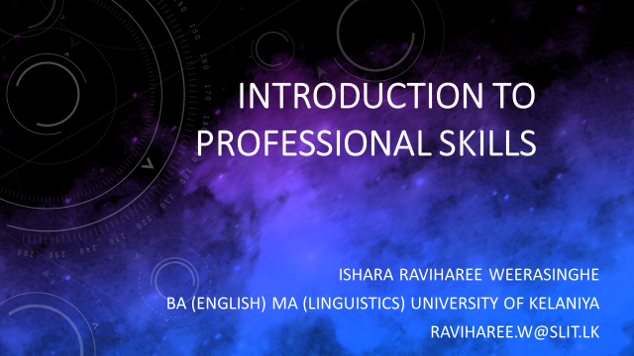

Slide 2
Introduction to the Course
Continuous Assessments : 100%
Assignment 1 – 30% Preparing CV
Cover letter
Facing Mock Interview
Assignment 2 - 20% Writing Abstracts / Research paper
Assignment 3 – 50% Self Reflective Portfolio and Presentation
Attendance : 80% Attendance is Compulsory
Enrolment Key : PS2023#@

Slide 3
What are Professional Skills?
Professional skills, also known as soft skills or employability skills, are the non-technical, interpersonal abilities that are essential for success in the workplace.
These skills complement an individual's technical knowledge and expertise, making them a well-rounded and valuable asset to employers.
Unlike technical skills, professional skills are transferable and can be applied across various roles and industries.

Slide 4
What are Employability Skills?
Definition of Employability Skills: Employability skills, also known as soft skills or transferable skills, are the essential qualities and attributes that go beyond technical knowledge and are sought after by employers.
Examples of Employability Skills: Communication, teamwork, problem-solving, adaptability, time management, and leadership.

Slide 5
Skills Necessary for Employment
Communication Skills: The ability to convey information effectively through various channels, including verbal, written, and non-verbal communication.
Critical Thinking and Problem-Solving Skills: Analyzing information, identifying challenges, and developing effective solutions.
Teamwork and Collaboration: Working effectively with others, sharing ideas, and supporting team goals.
Adaptability and Flexibility: Embracing change, being open to new ideas, and adjusting to different situations.
Time Management: Efficiently organizing and prioritizing tasks to meet deadlines.
Leadership: Guiding and motivating others towards a common goal.

Slide 6
Classifying Workplace Skills
Technical Skills: Specific expertise and knowledge required for a particular job or industry.
Soft Skills: Interpersonal and communication skills that enhance overall work performance and collaboration.
Transferable Skills: Versatile skills that can be applied across various roles and industries, such as problem-solving and adaptability.
Activity 1
Worksheet 1 – pair work

Slide 7
Values, Beliefs, Attitudes, and Character
Values: Core principles and beliefs that guide an individual's behavior and decision-making process.
Beliefs: Personal assumptions and convictions that shape how we perceive the world and ourselves.
Attitudes: An individual's predisposition to respond positively or negatively to specific people, situations, or ideas.
Character: The moral and ethical qualities that define an individual's overall integrity and reputation.

Slide 8
Values
Values are core principles and beliefs that guide an individual's behavior and decision-making process.
They serve as a moral compass, influencing how we interact with others and navigate life's challenges.
Personal values shape our priorities and help us determine what is right or wrong in various situations.

Slide 9
Examples of Values
Honesty: Being truthful and transparent in all actions, even when faced with difficult situations.
Integrity: Upholding strong moral principles and adhering to ethical standards.
Respect: Treating others with dignity, regardless of differences or disagreements.
Responsibility: Being accountable for one's actions and commitments.
Compassion: Showing empathy and understanding towards others' feelings and needs.
Excellence: Striving for high-quality and outstanding performance in all endeavors.
Fairness: Ensuring impartiality and equity in decision-making and interactions.
Courage: Facing challenges and standing up for what is right, even in the face of adversity

Slide 10
Beliefs
Beliefs are personal assumptions and convictions that shape how we perceive the world and ourselves.
They are deeply ingrained and can influence our thoughts, attitudes, and behaviors.
Beliefs may be shaped by personal experiences, cultural backgrounds, and upbringing.

Slide 11
Examples of Beliefs
Self-Efficacy: Believing in one's ability to accomplish tasks and overcome obstacles.
Growth Mindset: Embracing challenges and viewing failures as opportunities for learning and growth.
Optimism: Holding a positive outlook on life and expecting favorable outcomes.
Locus of Control: Believing in one's ability to influence events and outcomes in life.
Prejudices: Holding biased opinions about certain individuals or groups based on stereotypes.
Self-Worth: Believing in one's value and inherent dignity as a person.
Fatalism: Believing that events are predetermined and beyond one's control.

Slide 12
Attitudes
Attitudes represent an individual's predisposition to respond positively or negatively to specific people, situations, or ideas.
Attitudes can influence our behaviors and interactions with others.
They are often shaped by experiences, beliefs, and values.

Slide 13
Examples of Attitudes
Positive Attitude: Approaching situations with optimism and enthusiasm.
Open-Mindedness: Being receptive to new ideas and diverse perspectives.
Tolerance: Demonstrating acceptance and respect for differing opinions and beliefs.
Prejudice: Holding biased views and displaying discrimination towards certain individuals or groups.
Confidence: Possessing self-assurance and belief in one's abilities.
Cynicism: Exhibiting skepticism and distrust towards others' intentions.
Empathy: Understanding and sharing the feelings of others.

Slide 14
Character
Character refers to the moral and ethical qualities that define an individual's overall integrity and reputation.
It is demonstrated through consistent actions and behavior over time.
A strong character involves aligning one's actions with their values, beliefs, and attitudes

Slide 15
Examples of Character Traits
Trustworthiness: Being reliable, honest, and keeping promises.
Respectfulness: Treating others with kindness and consideration.
Responsibility: Taking ownership of one's actions and being accountable for their consequences.
Caring: Showing empathy and concern for the well-being of others.
Citizenship: Contributing positively to the community and society as a responsible member.
Fairness: Treating others equitably and without bias.
Courage: Acting bravely and standing up for what is right, even in challenging situations.

Slide 16
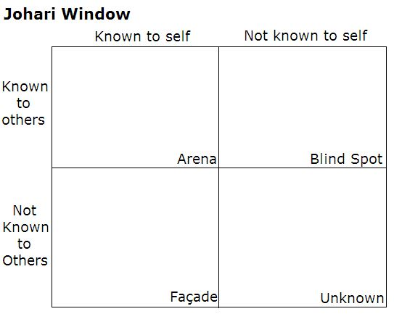
Johari window exercise
Johari Window: A graphic model of awareness in interpersonal relations
Developed by Joseph Luft (1916–2014) and Harrington Ingham (1916–1995) in 1955

Slide 17
Importance of Professional Skills
Enhancing Employability: How developing these skills increases the chances of securing and excelling in a job.
Workplace Success: How professional skills contribute to a productive and harmonious work environment.
Career Advancement: How continuous improvement of these skills can lead to promotions and leadership opportunities.

Slide 18
Tips for Developing Professional Skills
Continuous Learning: Seek opportunities to expand knowledge and skills through courses, workshops, and online resources.
Practice and Application: Find ways to apply and reinforce your skills in real-life situations.
Seek Feedback: Be open to feedback from colleagues, mentors, or supervisors to improve your professional skills.
Embrace Challenges: Step out of your comfort zone and take on new challenges to enhance your skills.

Slide 19
References
Peterson, C., & Seligman, M. E. P. (2004). Character strengths and virtues: A handbook and classification. Oxford University Press.
Rokeach, M. (1973). The Nature of Human Values. Free Press.
Schwartz, S. H. (1992). Universals in the content and structure of values: Theoretical advances and empirical tests in 20 countries. In M. P. Zanna (Ed.), Advances in Experimental Social Psychology (Vol. 25, pp. 1-65). Academic Press.
Festinger, L. (1957). A Theory of Cognitive Dissonance. Stanford University Press.
Fiske, S. T., & Taylor, S. E. (1991). Social Cognition (2nd ed.). McGraw-Hill.
Ajzen, I., & Fishbein, M. (1980). Understanding attitudes and predicting social behavior. Prentice-Hall.
Eagly, A. H., & Chaiken, S. (1993). The Psychology of Attitudes. Harcourt Brace Jovanovich.
Damon, W. (2004). What is Positive Youth Development? Annals of the American Academy of Political and Social Science, 591(1), 13-24.

Slide 20
Thank You

